Slide 1




Applied Data Science Project 4: Causal Inference
$$α→β?$$
$$P(T=1|\overset{⃑}{x})$$
$$δ_{ij}=|logit\left(e_{i}\right)−logit\left(e_{j}\right)|$$
$$E\left[Y_{1} −Y_{0}\right]$$
Group 5:
Sean Harris, Amir Idris, Chuyun Shu, Yandong Xiong, Ruize Yu

Slide 2
Outline
Assigned Algorithms
Our approach
Algorithm results
discussion

Slide 3
Assigned Algorithms
ATE Estimation Algorithm | Distance Metric | Propensity Estimation Model
Full Propensity Matching | Linear Propensity Score | Logistic Regression
Full Propensity Matching | Linear Propensity Score | L1 Penalized Logistic Regression(Lasso)
Full Propensity Matching | Linear Propensity Score | L2 Penalized Logistic Regression (Ridge)
Full Propensity Matching | Linear Propensity Score | Regression Trees
Full Propensity Matching | Linear Propensity Score | Boosted Stumps
Weighted Regression | N/A | L1 Penalized Logistic Regression(Lasso)

Slide 4




As a Review…
Model
$$e_{i}=P\left(T=1\right|\overset{⃑}{x}), ∀i$$
Distance Metric
Matching
Estimate ATE: $E\left[Y_{1} −Y_{0}\right]$
Matching
or
Model
$$e_{i}=P\left(T=1\right|\overset{⃑}{x}), ∀i$$
Estimate ATE: $E\left[Y_{1} −Y_{0}\right]$
Regression

Slide 5

Algorithm 1: Full Propensity Score matching
Full matching (Optimal Matching): Create subsets of matched groups, with each group having at least one treatment example and at least one control example, such that we minimize:
Advantages:
Uses all of the data
Minimizes overall discrepancy between matches
Can be adjusted with ratio limits in subgroups
disadvantages:
Time intensive (depending on implementation)
Can be challenging to implement
Effective sample size may be smaller due to weighting scheme
Stuart 2010, Hansen 2004

Slide 6

Algorithm 7: Weighted regression
Weighted regression: directly model the effect of the treatment variable by regressing on it. The estimated treatment effect will be the coefficient it is assigned in the following weighted linear regression:
Advantages:
Doesn’t require calculating distances, propensity scores used directly as weights
Easy to implement
Low time complexity
disadvantages:
Results can vary depending on t-test cutoff
The coefficients for the covariates are not useful/interpretable
No matched dataset obtained, which may be of use

Slide 7
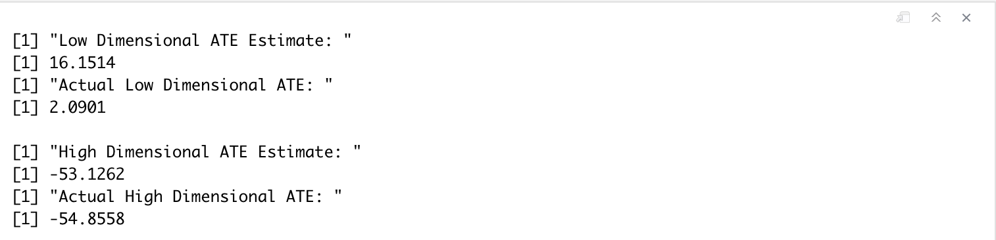
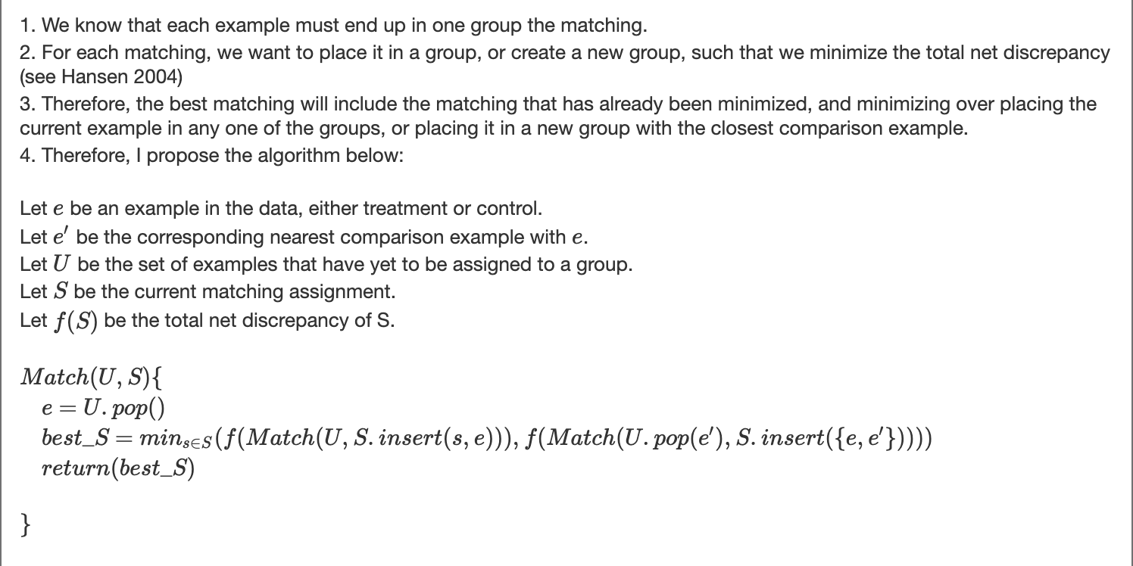
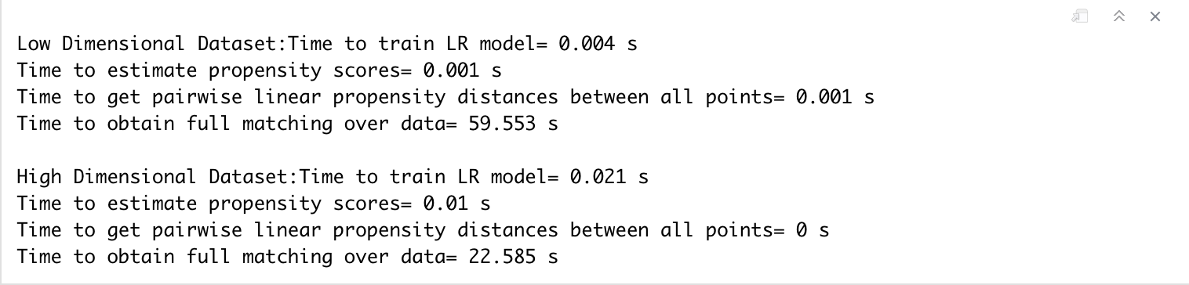
Full Matching approach
Implement from scratch?

Slide 8
Full Matching approach
Use MatchIt Package:
Train respective model on covariates
use default hyperparameters
Estimate propensity scores using that model
Using those propensity scores, run full matching
Estimate average treatment effect by regressing outcome on treatment, using weights from full matching, and taking coefficient

Slide 9
Weighted Regression approach
Train respective model on covariates (Lasso Logistic Regression)
use default hyperparameters
Estimate propensity scores using that model
Regress outcome on treatment and each covariate, discard insignificant covariates
Compute weighted regression of outcome on treatment and remaining covariates and inverse propensity scores, ATE is coefficient on treatment

Slide 10
ATE Estimation Results
 | Low-Dim ATE Estimate | Low-Dim Error (SDs) | High-Dim ATE Estimate | High-Dim Error (SDs)
A1 + D3 + P1 | 1.725128 | -0.02925137 | -60.14118 | -0.09748049
A1 + D3 + P2 | 1.171943 | -0.07358735 | -57.18506 | -0.04295943
A1 + D3 + P3 | 1.666441 | -0.03395494 | -59.20897 | -0.08028740
A1 + D3 + P4 | 4.369954 | 0.18272302 | -52.62841 | 0.04108073
A1 + D3 + P5 | 2.371125 | 0.02252324 | -53.38666 | 0.02709601
A7 + P2 | 2.090175 | 6.028979e-06 | -57.95906 | -0.05723466

Slide 11
Empirical Time complexity results
Low-Dimensional Dataset: | Propensity Scoring Model Training | Propensity Score Estimation | Propensity Matching | Regression | Total
A1 + D3 + P1 | 0.021 | 0.001 | 0.309 |  | 0.331
A1 + D3 + P2 | 0.036 | 0.029 | 0.330 |  | 0.395
A1 + D3 + P3 | 0.033 | 0.010 | 0.233 |  | 0.276
A1 + D3 + P4 | 0.050 | 0.026 | 0.138 |  | 0.214
A1 + D3 + P5 | 0.034 | 0.007 | 0.150 |  | 0.191
A7 + P2 | 0.017 | 0.005 |  | 0.091 | 0.113

Slide 12
Empirical Time complexity results (Seconds)
High-Dimensional Dataset: | Propensity Scoring Model Training | Propensity Score Estimation | Propensity Matching | Regression | Total
A1 + D3 + P1 | 0.452 | 0.006 | 4.211 |  | 4.669
A1 + D3 + P2 | 3.788 | 0.018 | 2.934 |  | 6.74
A1 + D3 + P3 | 0.807 | 0.014 | 2.857 |  | 3.678
A1 + D3 + P4 | 1.149 | 0.007 | 4.341 |  | 5.497
A1 + D3 + P5 | 0.436 | 0.027 | 4.072 |  | 4.535
A7 + P2 | 3.625 | 0.014 |  | 1.392 | 5.031

Slide 13
Verdict?
Our preferred causal inference algorithm is…
Weighted Regression with L1 Penalized Logistic Regression Propensity Scoring
Achieved comparable estimates to all other combinations
Achieved best estimate on low-dimensional dataset
Regression itself faster than full matching
Can achieve even faster estimates with different scoring model
Easy to implement
Easier hyperparameter tuning: alpha-level vs. group ratio

Slide 14
Thank You For Listening! Questions?

